Slide 1

Data Analysis
on FIFA 20 Players
IST 718 Project Presentation
Group 10
Jinlong Zhou, Kun Yang, Yanning Fan, Zimeng Zhang

Slide 2
CONTENTS
Overview
Goals
Data exploration
Summary of Methods
Quality Assessment of Prediction and Inference
Problems Encountered
Work Distribution

Slide 3
Overview
FIFA 20 is a football simulation video game published by Electronic Arts as part of the FIFA series. It is the 27th installment in the FIFA series, and was released on 27 September 2019 for Microsoft Windows.
Throw this analysis we can understand how should we select our FUT team for online play against rivals. For the project we are trying to provide a reference for player reference and salary evaluation. The results also can help the real word football club to make a decision like finding the best cost performance player.

Slide 4
Goals
How to improve value is a crucial question for both game players and real life soccer players. What we do here is to figure out key factors to help players to increase the value most efficiently.
For the new players, in most cases they don’t know which is the best position for them. So, we are going to build the model to solve this question.
Sometimes players or managers want to pick the substitute for the team, but the question is there are thousands of players for them to pick. What we do here is to build a recommender system for helping them.

Slide 5
Goals
Perdiction:
To predict the value of a player;
regression model
To predict the best fitting position of a player;
classification model
To create a recommender system for alternate players.
Inference:
We are going to find out which features are the most important for predicting these target.

Slide 6

Data Exploration

Slide 7
Overview of FIFA 20 Dataset
18,278 rows * 104 columns
Feature | Type | Description
sofifa_id | str | Unique identifier of a player
shooting | num | Score of a player's shooting ability
value_eur | num | value of the player in EUR
wage_eur | num | wage of the player in EUR

Slide 8
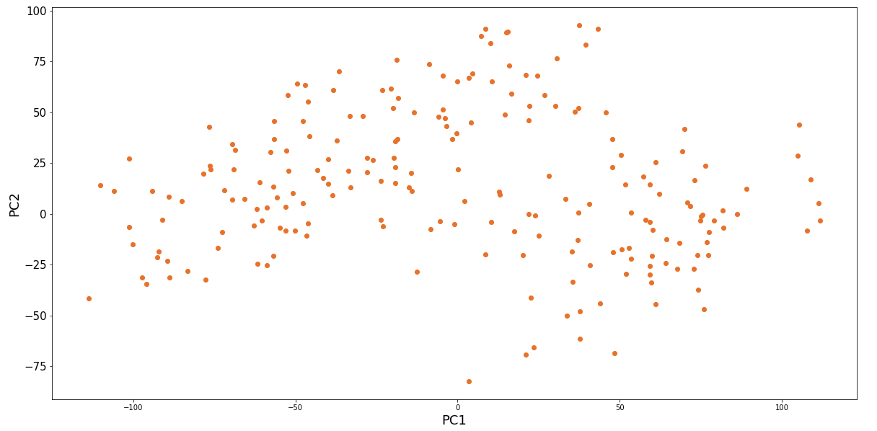
Visualization of FIFA 20 Dataset

Slide 9
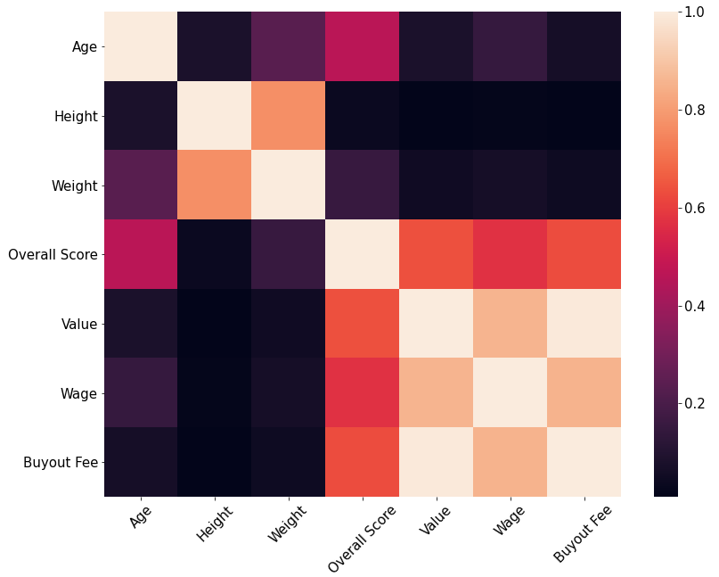
Correlation of Key Numerical Attributes

Slide 10
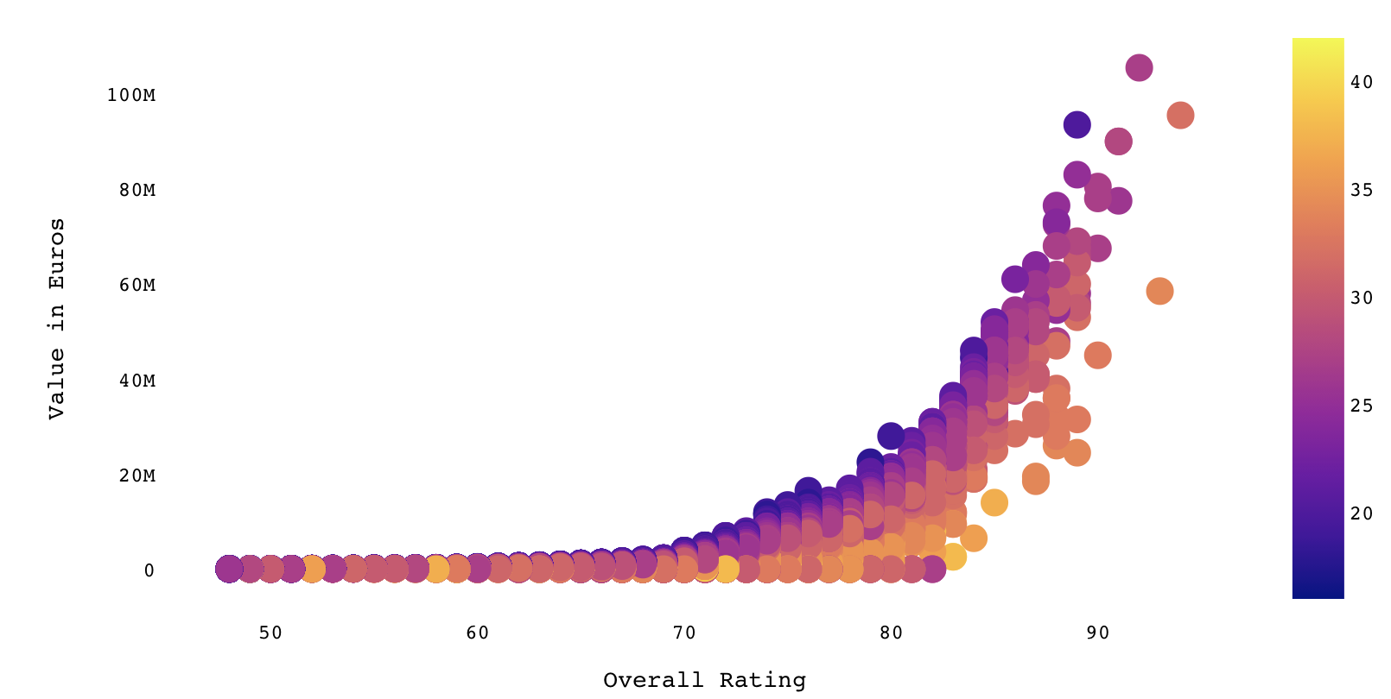
Value vs Overall Rating

Slide 11
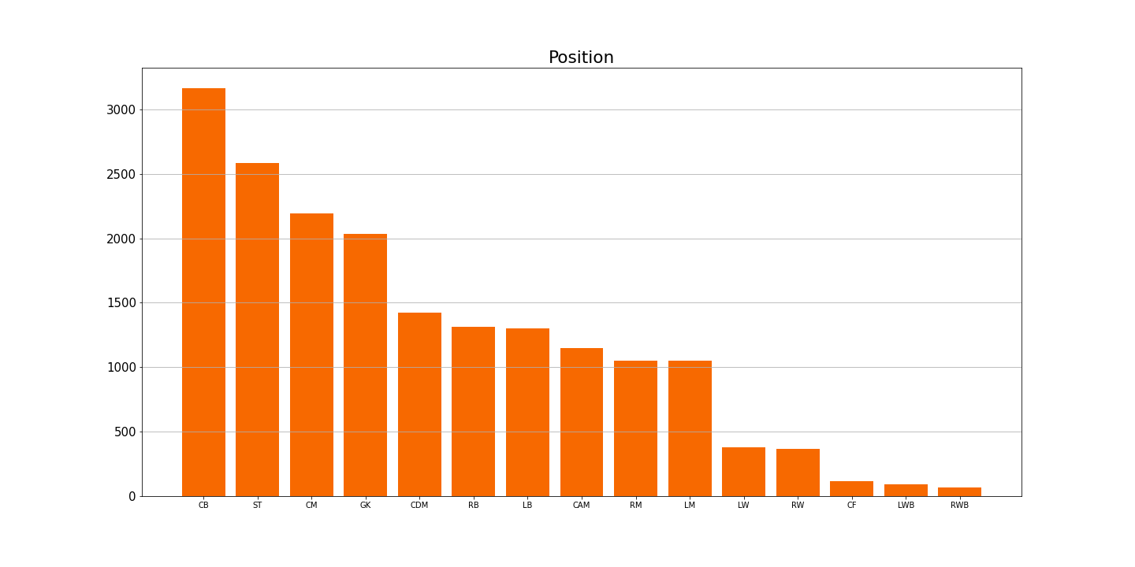
Player Count by Position
Count
Position

Slide 12
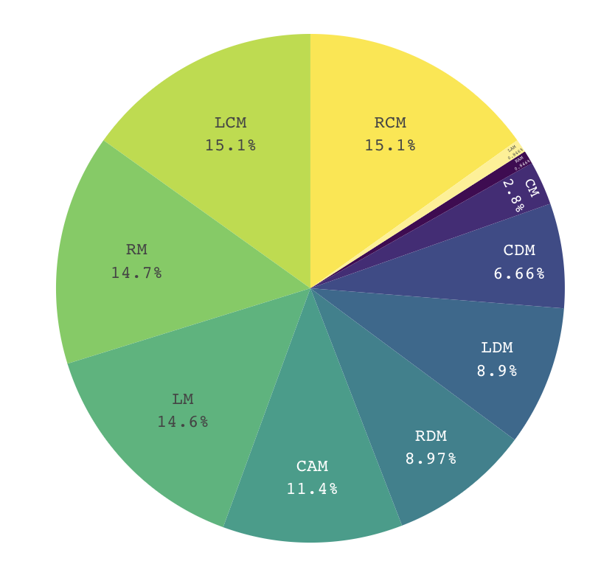
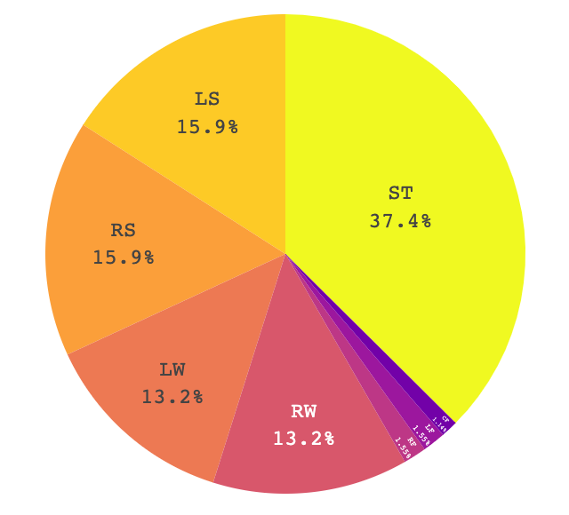
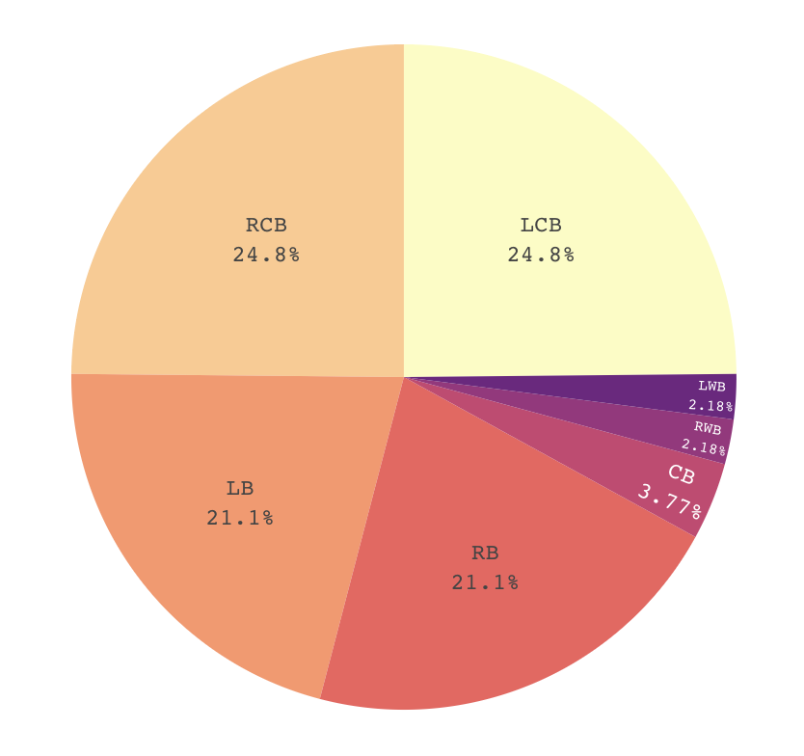
Proportion of Players per Position
Attacker
Midfielder
Defender

Slide 13
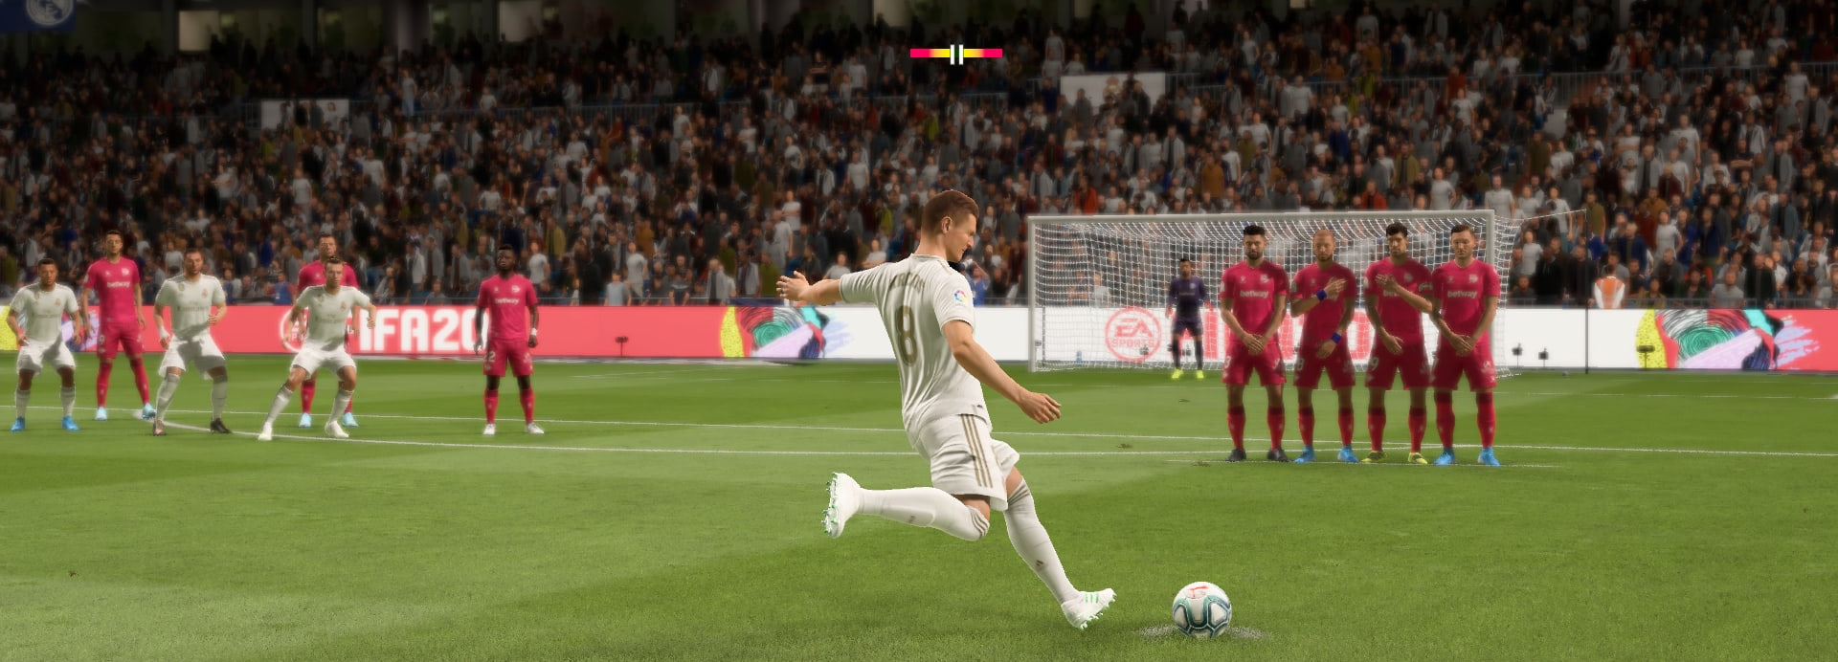
Model Interpretation

Slide 14
Methods Used for Regression
Regression: Predict value of a specific player.
Random Forest Regression
Gradient Boosting Regression
Linear Regression with Regularization

Slide 15
Methods Used for Classification and Clustering
Classification: Predict position for new player.
Logistic Regression
Gradient Boosting Classifier
Support Vector Machine
Clustering: Alternate players recommend system.
K-Means
PCA

Slide 16
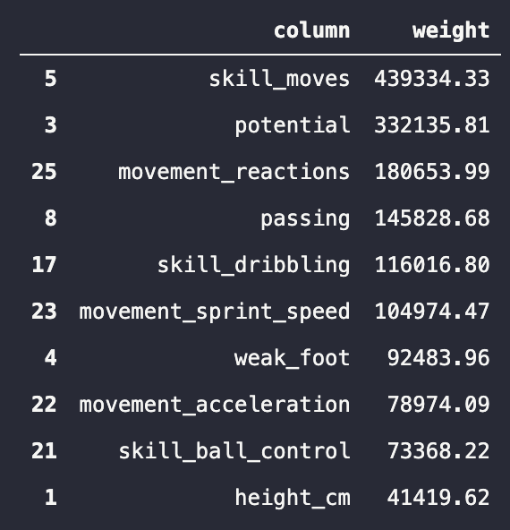
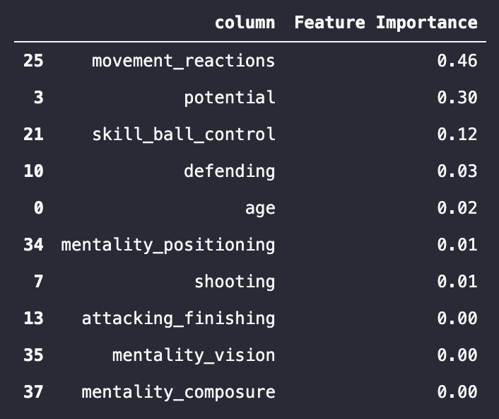
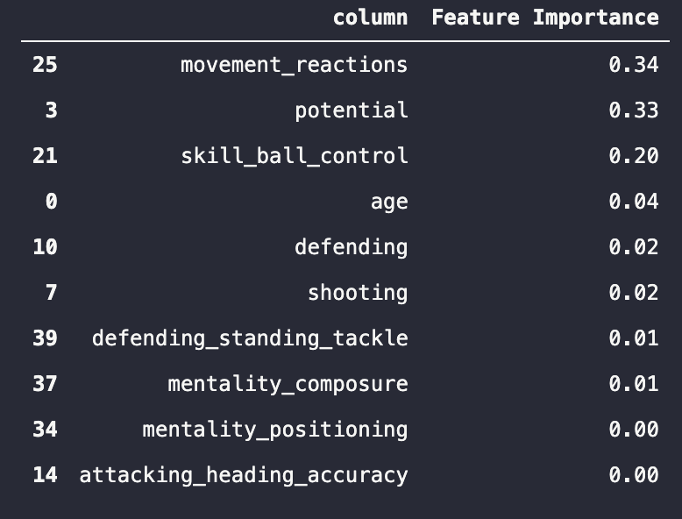
Quality Assessment of Prediction and Inference
Regression Model for Value
Linear Regression
Random Forest
Gradient Boosting

Slide 17
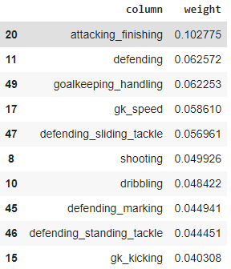
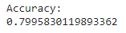
Quality Assessment of Prediction and Inference
Classification Model
GOAL
To predict position of a player via given features.
SOLUTION
We conduct a multiclass classification using Multinomial Logistic regression and Random Forest algorithm.

Slide 18
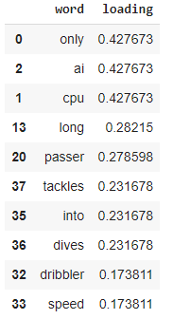
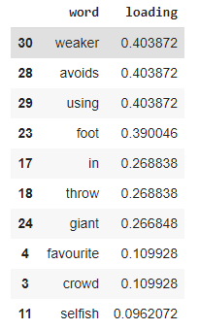
Quality Assessment of Prediction and Inference
Recommendation System
PC1
PC2
GOAL:
To figure out the most similar player and build recommendation system.
SOLUTION:
We conduct a sentiment analysis on player_traits column. Then apply PCA algorithm to visualize result in 2D space.

Slide 19
Problems Encountered
Some features have high correlation, so we can select one of them
value_eur, wage_eur, release_clause_eur --> value
Too many labels (27 labels) in one feature (position) may reduce the efficiency of the model, so we can merge some similar labels
ls st rs lw lf cf rf rw --> forward
lam cam ram lm lcm cm rcm rm ldm cdm rdm --> midfielder
lb lcb cb rcb rb lwb rwb --> defend
gk --> gk

Slide 20
Work Distribution
CLEAN DATA
DATA EXPLORATION
FEATURE SELECTION
Kun Yang
BUILD AND TEST REGRESSION MODEL
Random Forest Regression
Gradient Boosting Regression
Linear Regression with Regularization
Jinlong Zhou, Zimeng Zhang
BUILD AND TEST CLASSIFICATION MODEL
Logistic Regression
Gradient Boosting Classifier
Support Vector Machine
YANNING FAN
BUILD AND TEST CLUSTERING MODEL
PCA
K-MEANS
Kun Yang
PREDICTION RESULT
RECOMMENDATION DISPLAY
All Team Members
SUMMARIZE THE RESULT
IMPROVEMENT
GENERATE THE SLIDES AND REPORT
All Team Members

Slide 21
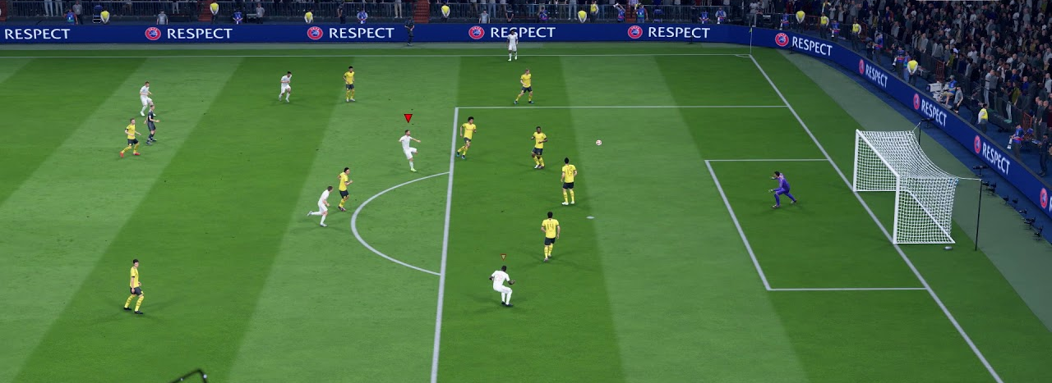
Q&A

Slide 22
Thank you!
Data Analysis on FIFA 20 Players
Group 10
Jinlong Zhou, Kun Yang, Yanning Fan, Zimeng Zhang

